Slide 1
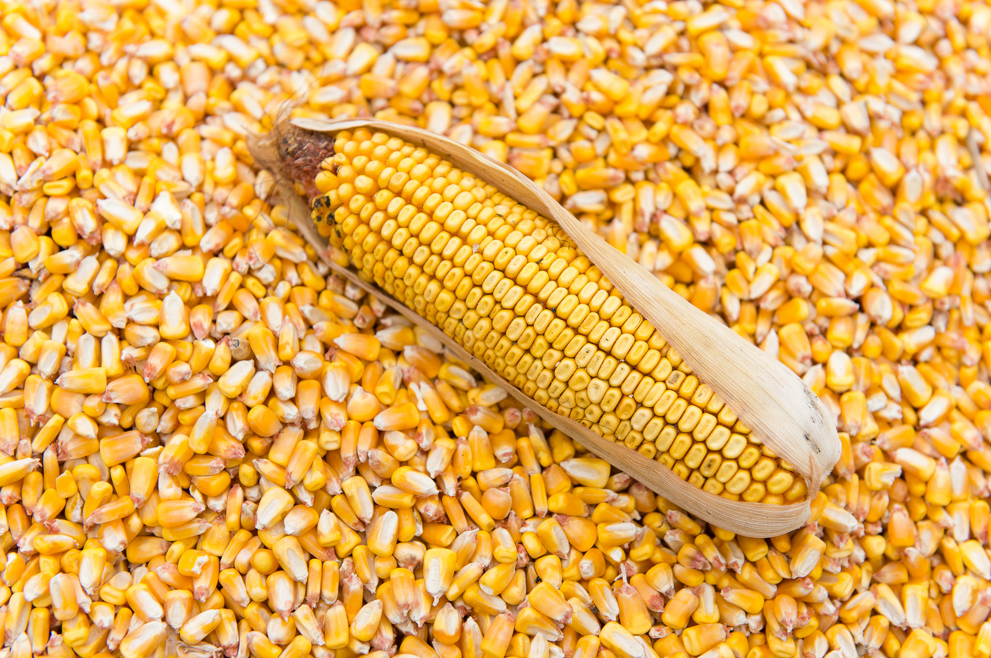
From Better Corn to New Plant Paradigms
Daniel Berleant*
Kori Bohon
Phil Williams
Elizabeth Hood
*Responsible for any errors
Image source: grains.org/buying-selling/corn-gluten

Slide 2
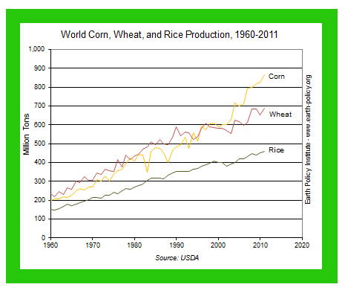
Corn is Important!
Ave. 800 kernels per ear
Nutritious & delicious
Low in lysine
Deficiency causes
Fatigue
Anemia
Hair loss
. . .

Slide 3
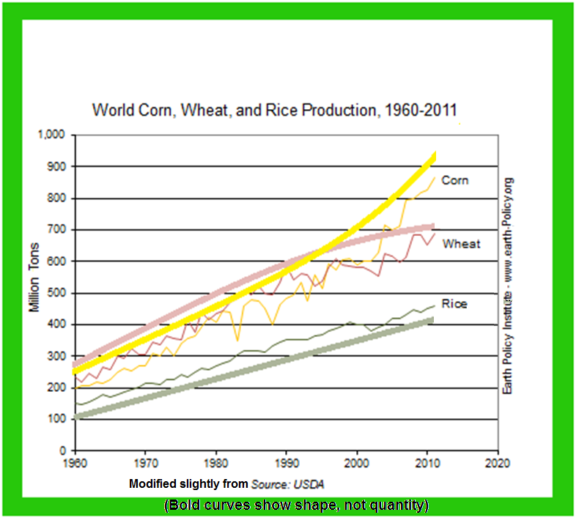

Slide 4
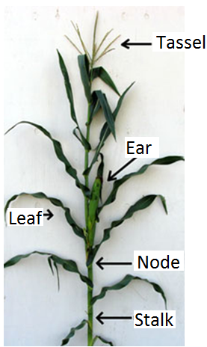
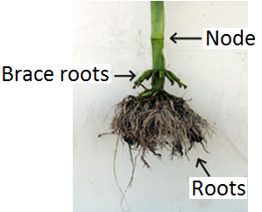
Zea mays (corn, maize)
How is a corn kernel like a potato chip?
Images slightly modified from plantandsoil.unl.edu/croptechnology2005/UserFiles/Image/siteImages/CornRootsCBSM.jpg

Slide 5
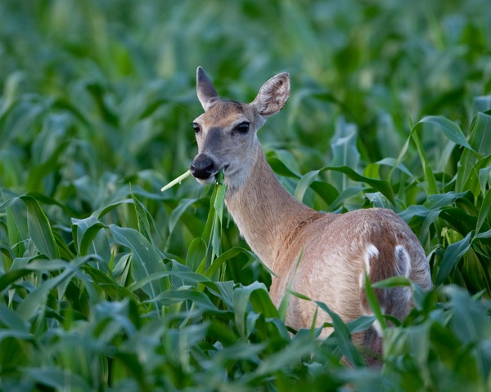
We’re Not the Only Ones Who Like Corn!
Image: stevecreek.com/whitetail-doe-eating-corn-plants/

Slide 6

Corn’s Importance Helps Motivate Some Research Goals
Better information retrieval, knowledge extraction about corn
Lessons would presumably generalize to other domains
Genetic engineering for better corn
In particular, protein content
Lessons would presumably generalize to other domains
Streamlining applications to APHIS
… etc., to grow GMO corn
Lessons would presumably generalize
E.g. to other domains, agencies, and countries
Notes:
APHIS – USDA’s Animal and Plant Health Inspection Service

Slide 7
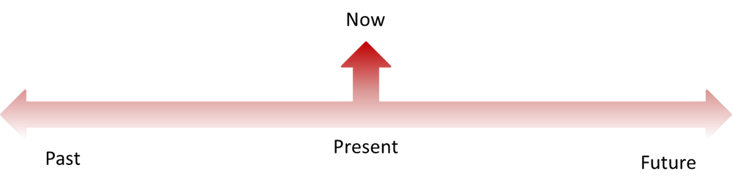
Outline of Today’s Presentation
A few remarks on different yet related projects I have participated in
This part we’ll call research
Plant-related paradigms that may come to fruition in the future
This part we’ll call science fiction
source: ahaseniorproject2017.wordpress.com/2017/01/24/past-impacting-the-present

Slide 8
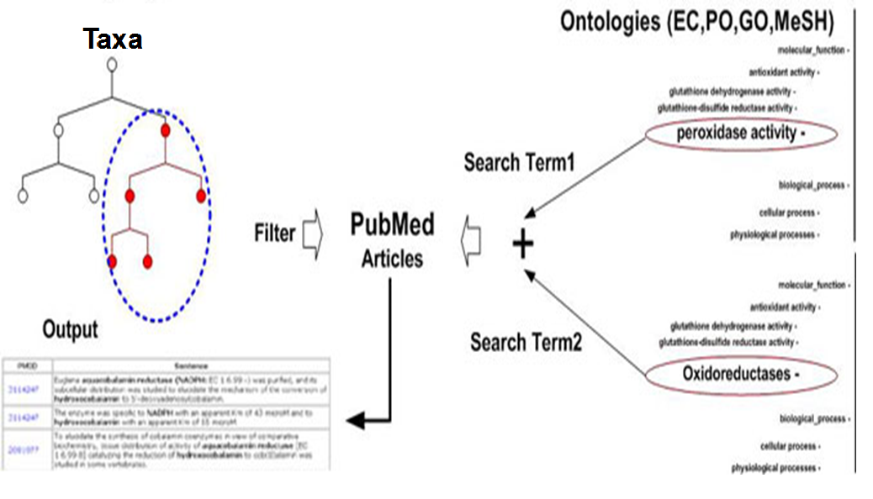
PathBinderH Project: Information Retrieval
Major operations shown:
Selecting the query terms
Setting the taxonomy filter

Slide 9
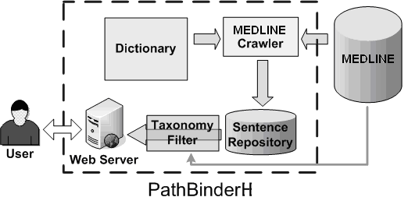
Architectural Overview of PathBinderH

Slide 10
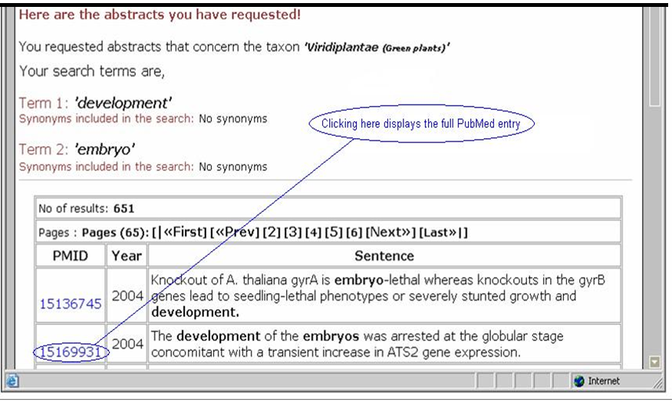
Sentences (including titles) containing two specified terms

Slide 11
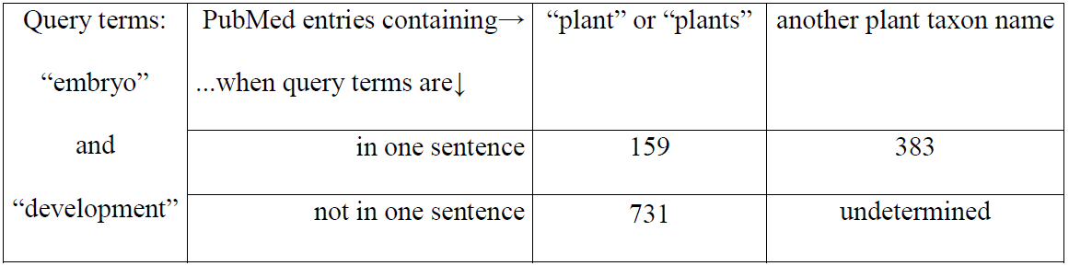
The Linnaean Taxonomy Tree Helps

Slide 12
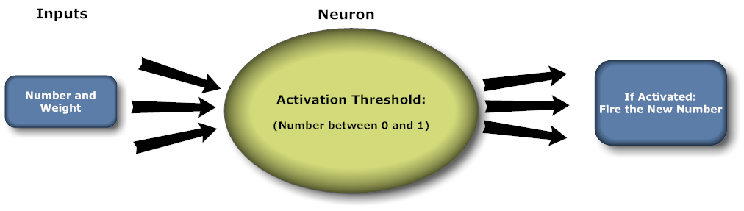
Corn Protein Project: From Sentence Retrieval to Information Extraction

Slide 13
Sentence Scoring Algorithm
1: Give the sentence an initial score of 0

Slide 14
Sentence Scoring Algorithm
2: If the sentence contains the term ‘Kjeldahl’ then add 1 to the score.

Slide 15
Sentence Scoring Algorithm
3: If the sentence contains <protein> and <number> then add 1 to the score.

Slide 16
Sentence Scoring Algorithm
4: If the sentence contains <protein> and <number> and at least one of the following: <content>, <corn>, <percent> then add 1 to the score.

Slide 17
Sentence Scoring Algorithm
5: If the sentence contains <protein> and <number> and at least two of the following: <content>, <corn>, <percent> then add 1 to the score.

Slide 18
Sentence Scoring Algorithm
6: If the sentence contains <protein> and <number> and all three of the following: <content>, <corn>, <percent> then add 1 to the score.

Slide 19
Sentence Scoring Algorithm
7: If the sentence contains <corn>, <protein>, and the two-term template <number><percent> then add 1 to the score.

Slide 20
Sentence Scoring Algorithm
8. If the sentence contains <corn> and the template <number><percent>_____<protein> then add 1 to the score.

Slide 21
Sentence Scoring Algorithm
9: If the sentence contains <corn> and the template <number><percent><protein> then add 1 to the score.

Slide 22
Sentence Scoring Algorithm
10: If the sentence contains <corn> and the template <protein>____<content>____<number> <percent> then add 1 to the score.

Slide 23
Sentence Scoring Algorithm
10a: If the sentence contains <corn> and the template <content>____<protein>____<number> <percent> then add 1 to the score.

Slide 24
Sentence Scoring Algorithm
11: If the sentence contains the term <corn> and the two templates <protein><content> and <number><percent> then add 1 to the score.

Slide 25
Sentence Scoring Algorithm
12: If the sentence contains <corn> and any of the following templates:
<protein> <number> <percent> <content>
or
<protein> <content> of <number> <percent>
or
<content> <number> <percent> <protein>
then add 1 to the score.

Slide 26
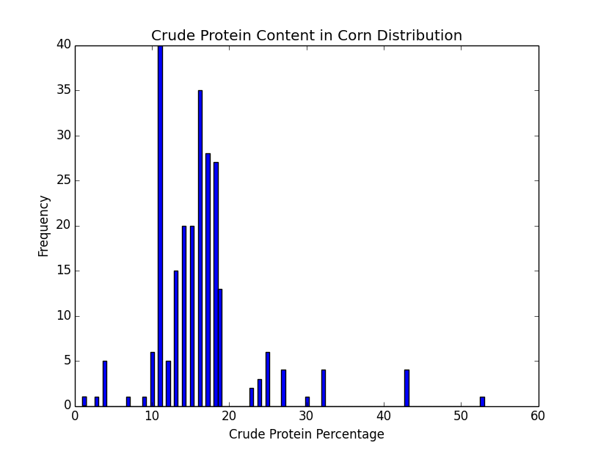
Knowledge Extraction Can Help

Slide 27
Interaction Identification Projects: Getting Interactions from Sentences
85% of biomolecular interactions
are described within a sentence
Table 2 in:
J. Ding, D. Berleant, D. Nettleton, and E. Wurtele, “Mining MEDLINE: abstracts, sentences, or phrases?,” Pacific Symposium on Biocomputing 7 (2002), Kaua'i, Hawaii, Jan. 3–7, pp. 326–337. (Also available at psb.stanford.edu.)
Ding was my PhD student
Paper cited 298 times per scholar.google.com
Regional conference, not “A” journal, so does not count toward P&T!

Slide 28
Example sentence
S1. Glutathione peroxidase (Se-GPx) is a selenoenzyme which catalyzes the reduction of hydroperoxides by glutathione (GSH), in most mammalian cells.
(Source: Chaudière J, Possible role of glutathione peroxidase in the regulation of collagenase activity. Ann Biol Clin. 1986, 44: 181-187.)

Slide 29
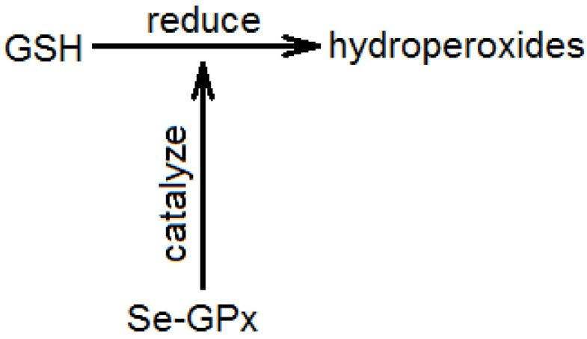
Diagram of the Interaction in S1
Interaction between a chemical and a process.

Slide 30
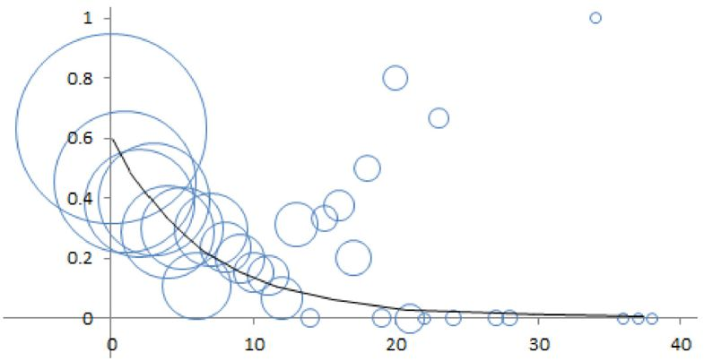
Nonlinear regression curve for
p(interaction-indicating term is correct)
as a function of the near distance
Near distance = number of words between an IIT and the nearest biomolecule in the pair
Bubble areas reflect numbers of sample sentences

Slide 31
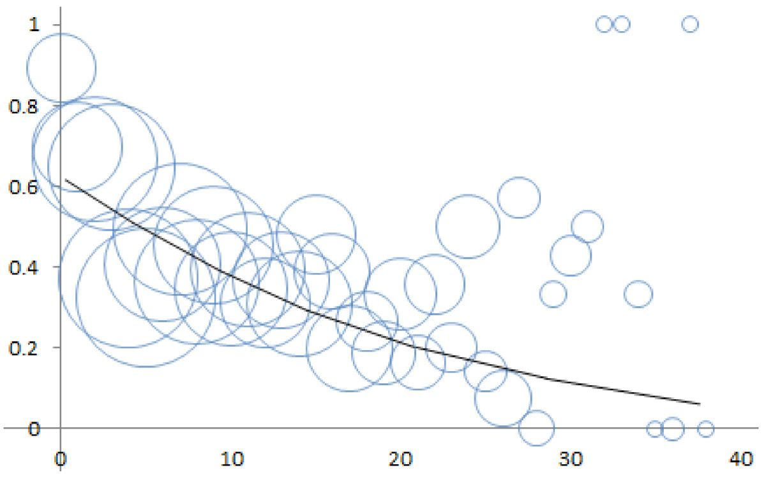
Regression curve for p(interaction-indicating term is correct) as a function of the far distance
Far distance = number of words between an IIT and the farther biomolecule name in the pair

Slide 32
A Name for the Biomedical Text Mining Field?
“bibliomics” (“About 2,180 results,” 2/20/2019)
“bibliome” (“About 18,500 results,” 2/20/2019)
“textomics” (“About 6 results,” 2/20/2019)
“textome” (“About 1,880 results,” 2/20/2019)
“literaturomics” (“About 6 results,” 2/20/2019)
“literaturome” (“About 196 results,” 2/20/2019)

Slide 33
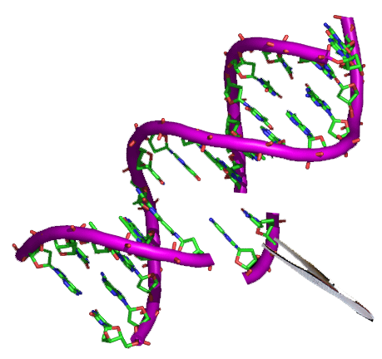
Corn, Protein, and Bioinformatics Project (Ongoing with E. Hood, P. Williams, & K. Bohon)
Motivation:
Protein accumulation in corn has increased in recent decades
It’s tractable, so let’s find out why, to do it even better
Goal:
Determine the epigenetic factors influencing recombinant protein accumulation in genetically engineered corn plants
Broader Impact:
Knowledge gained should generalize to other grain crops
Image source: en.wikipedia.org/wiki/File:Genetic_engineering_logo.png

Slide 34
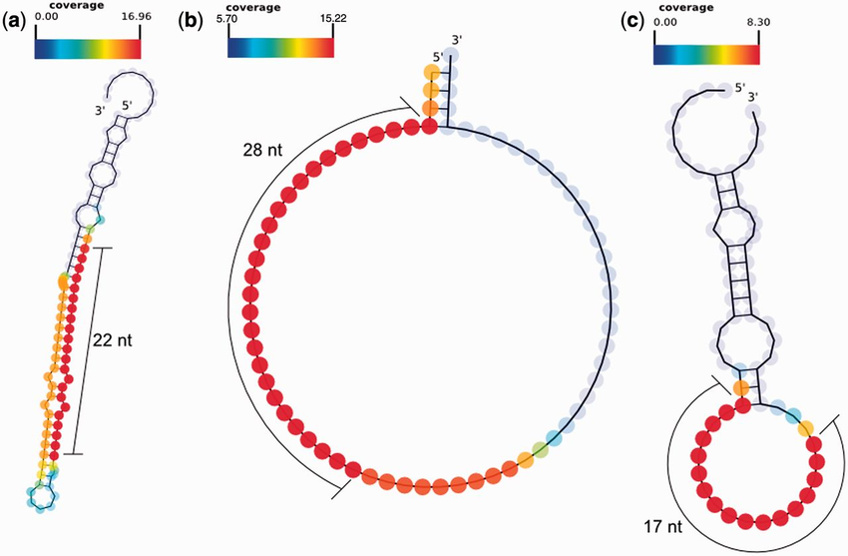
Specific Aim #1: Sequencing
Sequence corn transcriptomes
Including smRNAs and lncRNAs of high and low accumulation phenotypes
Also control non-transgenic elite inbred
At different embryo maturation time points
Objective:
Determine which transcripts are regulated by the unknown relevant mechanisms
Image source: www.researchgate.net/figure/smRNA-seq-reads-plotted-on-the-predicted-RNA-secondary-structures-using-SAVoR-14-for_fig5_236934214

Slide 35
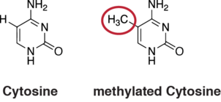
Specific Aim #2: Identify Methylation
Determine the methylation statuses of relevant gene regions
Compare:
High protein accumulation phenotypes
Low protein accumulation phenotypes
Control non-transgenic elite strain
What methylations affect
protein accumulation?
Image source: https://en.wikipedia.org/wiki/DNA_methylation

Slide 36
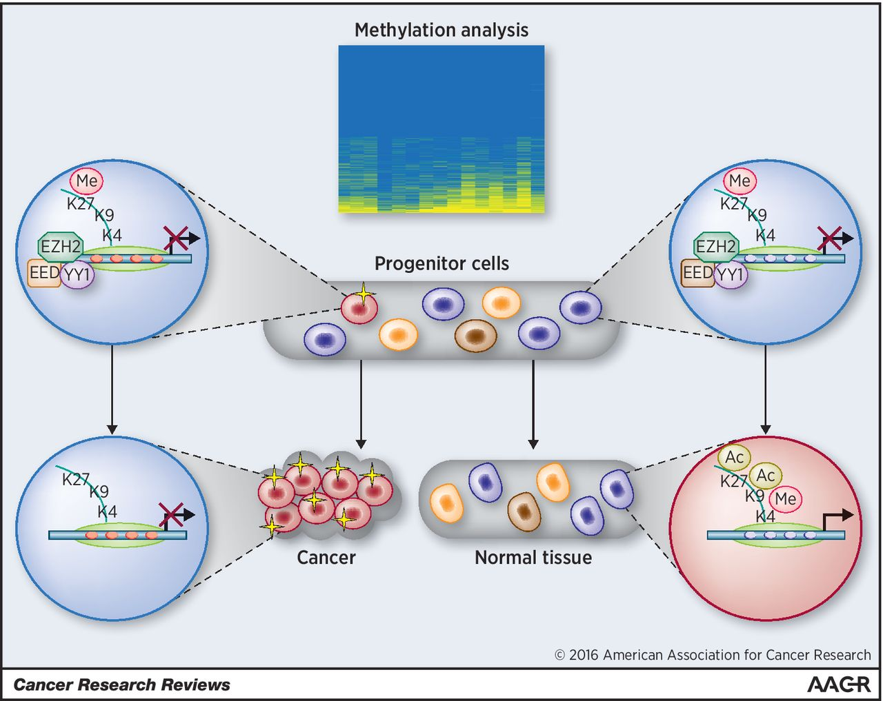
Specific Aim #3: Understand Methylation
What methylations affect protein accumulation?
Analyze across strains:
Sequence data
Methylation data
Protein accumulation data
Compare and understand

Slide 37

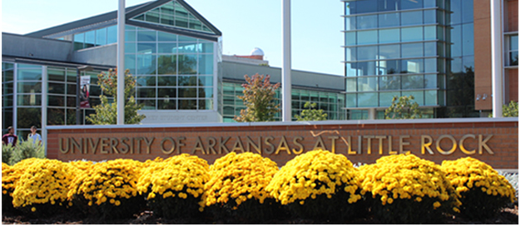
Working with E. Hood’s Lab at ASU — Our Portion at UA Little Rock
We are not focused on
Wet lab activities, sequencing
We are focused on
Analyzing and understanding
the biological data

Slide 38
Genome – The DNA of the host system
Transcriptome – The entire population of RNA molecules expressed in the host system
Proteome – The entire compliment of proteins that are or can be expressed in the host system
Epigenetics – How genes are regulated to bring about change in the host system

Slide 39
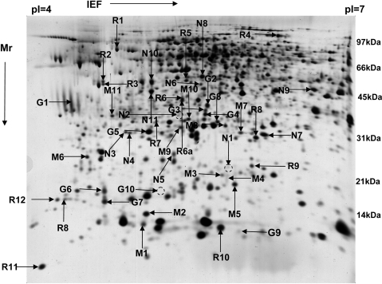
Objective 1: Transcriptome Variation Analysis
Objective 2: Apply Machine Learning to Transcriptome Analysis
Objective 3: Machine Learning Prediction of lncRNAs
Objective 4: Learn RNA Interactions in Gene Regulation in Corn *
Objective 5: Obtain Effects of Genetic
Engineering of Corn on Total
Proteomic Expression Profile
Image source: www.ncbi.nlm.nih.gov/pmc/articles/PMC2791117

Slide 40

Slightly modified from: http://www.futurenetworkmarketing.com/images/the-future.jpg
Notes:
Wouldn't it be nice if the future came with specific, clear, unambiguous directions

Slide 41
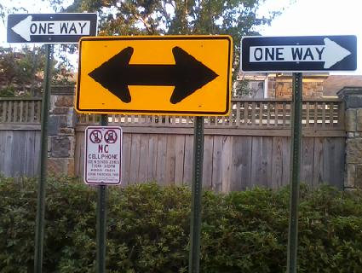
Notes:
Unfortunately, it doesn't!
It is often said that time goes in only one direction
Unfortunately, we don't know which direction!
''It is very hard to predict, especially the future“ - Bohr, Petersen
But together, let us try

Slide 42
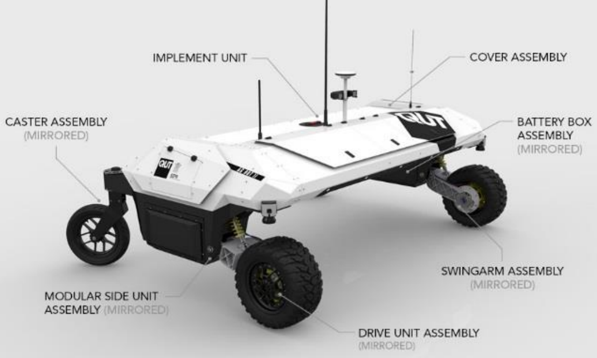
New Plant Paradigms I: An Hour’s Work Yields a Week’s Food
USA, 1900: 41% of employed people work in agriculture
USA, 2000: 1.9%
1.9% of a 40-hour work week is
<drum roll…..>
45 minutes, 36 seconds
1 week (39.5 hours) of work per year
…if all you needed was food
Weederbot image: zenodo.org/record/891522/files/ACPA%20Paper%20130.pdf
Notes:
Free food, food grown everywhere including backyards, people working less (if you want nothing from society besides food, then you should only have to work 1 week per year!)

Slide 43
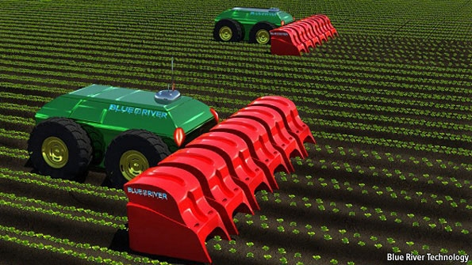
Farming more than grass
Lettucebots

Slide 44

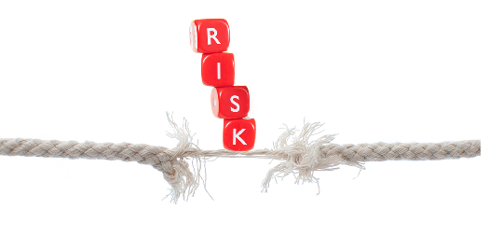
New Plant Paradigms II: From Centralized to Decentralized Food Production
For most food, farm to table requires long distance transport
Modern society is highly vulnerable to transportation disruption
Natural disaster, war, societal breakdown: unlikely but possible
Why not decentralize farming?
Why let your back yard just sit there?
Home agribots will soon be able to help!
Sources: (t) www.123rf.com/photo_8081287_isolated-studio-shot-of-a-businessman-sitting-using-a-laptop-computer-while-sitting-in-a-chair.html; (b) www.gfi.com/blog/wp-content/uploads/2012/08/BOYD-the-risk.jpg.

Slide 45
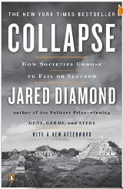
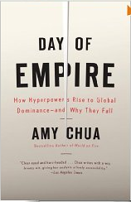

Why civilizations rise and fall
Numerous theories,
including
Environmental overshoot (e.g. Jared Diamond)
Immigration policy (e.g. Amy Chua)
Sociopolitical complexity (e.g. Joseph Tainter)

Slide 46
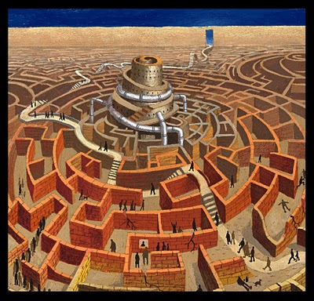
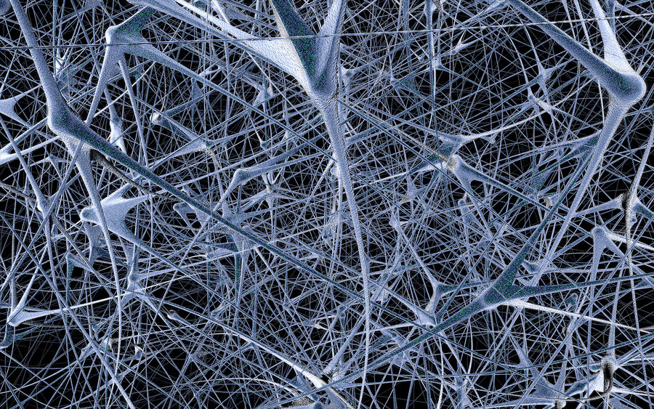
Source: marktattersall.com/wp-content/uploads/2013/02/neural_network_by_wieschoo-d5gyq2l.jpg
Source: www.thepolisblog.org/2010/05/decentralization-for-development.html

Slide 47
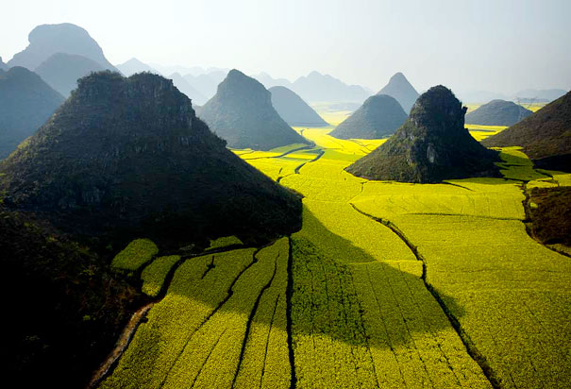
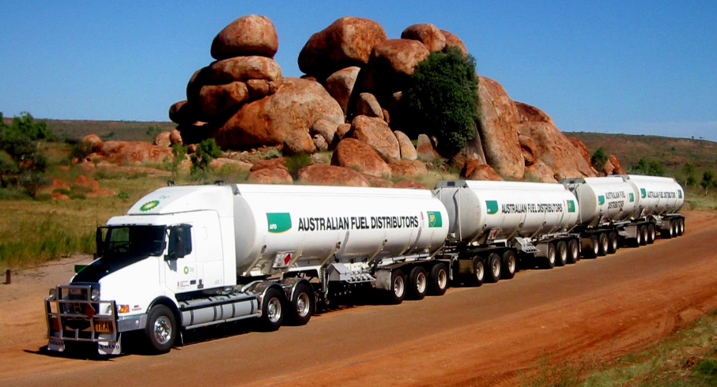
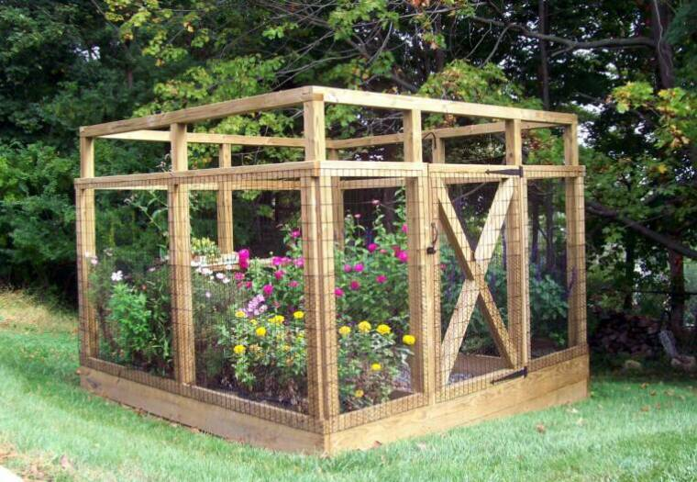
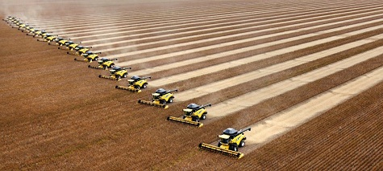
wallpperhd.com/truck.html
Source: orientalflowers.wordpress.com/category/nature-scenery-landscapes/hills
Source: www.davidicke.com/headlines/80376-modern-colonialism-foreign-investors-buy-up-vast-amounts-of-developing-world-farmland
How to compete?
Source: www.teichgardensystems.com

Slide 48
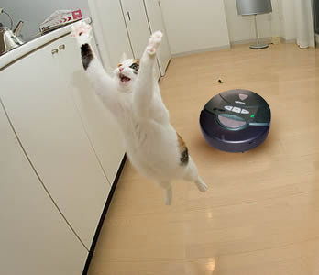
Robots are poised for takeoff
Robo-vacuum cleaners work on floors
The outdoors has a floor
We call it the ‟groundʺ
Source: http://www.dumbening.com/RSS/7-1-07.html

Slide 49
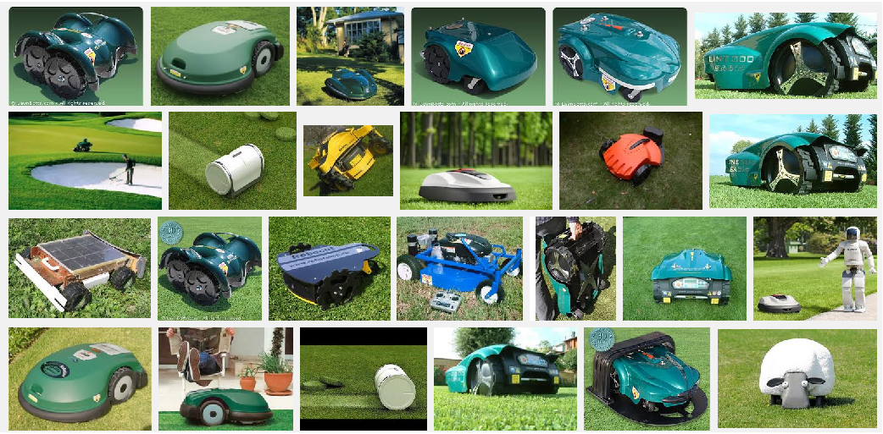
Robot lawnmowers: primitive grass farming bots!

Slide 50
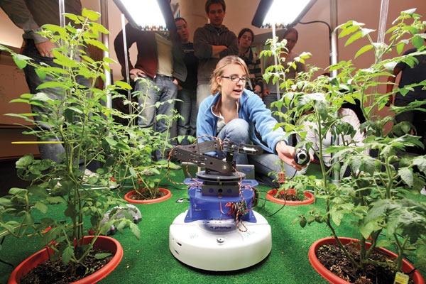
Tomatobot
www.technologyreview.com/article/413122/robogardener/

Slide 51
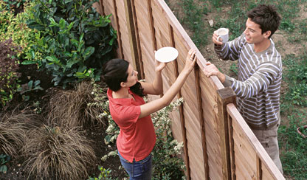
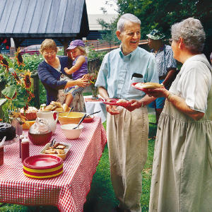
You and your neighbors
Let's say you have a broccobot
Your neighbor has a raspberrybot
Work out a trade!
"Man does not live by broccoli alone"
Neighbors trading with neighbors
. . . building communities with growbots!
www.parade.com/news/2010/05/02-meet-the-neighbors.html
www.cityofyukonok.gov/city-departments/emergency-management/family-disaster-plan/neighbors-helping-neighbors/

Slide 52
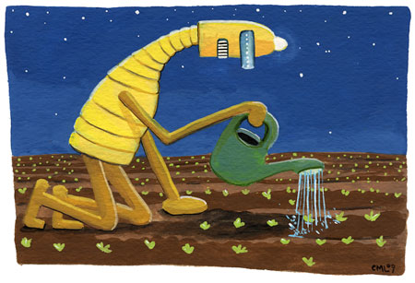
Agribots
From mowers to mowerbots to single-cropbots to everybots
Artist: Christine M. Larsen. www.thelittlechimpsociety.com/?s=larsen;
see e.g. http://shop.christinelarsen.com/product/robot-of-the-month-club

Slide 53

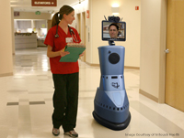
Telecommuting=Less Roadway=More Local Food Production
Repurpose roads for growing crops?
www.scitechstory.com/images/telerobot.jpg www.vitaver.com/blog/2010/07/present-trends-in-telecommuting
Notes:
Quip ''ultimate home office''
Same guy
Telerobots are for sale now
What might happen?
Any other predictiongoals to consider?

Slide 54
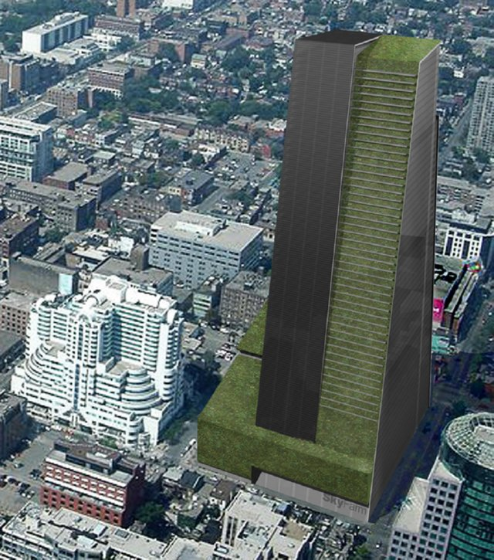
Plan for agricultural tower
58 story ‟Sky Farmʺ
Proposed for Toronto
8 million sq. Feet
180 acres+
35,000 people (supposedly)
Image from www.inspirationgreen.com/vertical-farms.html

Slide 55
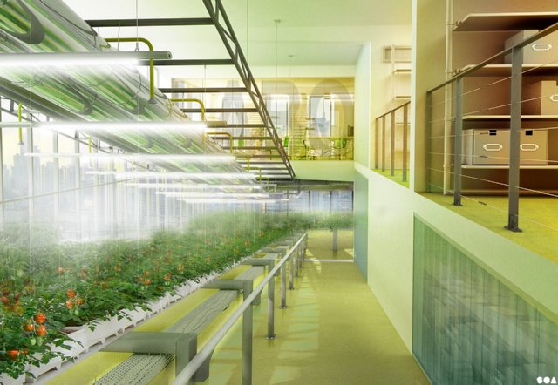
Plan
Hydroponics
+
offices
SOA Architects (France)
Image from www.inspirationgreen.com/vertical-farms.html

Slide 56
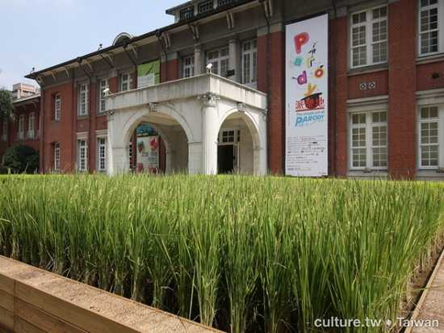
Rice can grow beside buildings, roadways
travel.mediamatic.net/page/55990/en

Slide 57
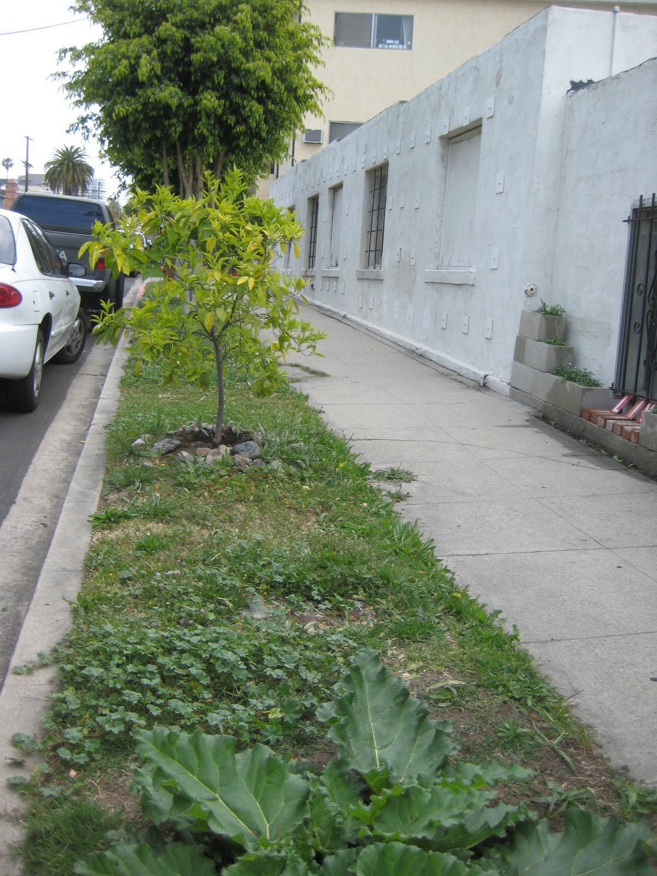
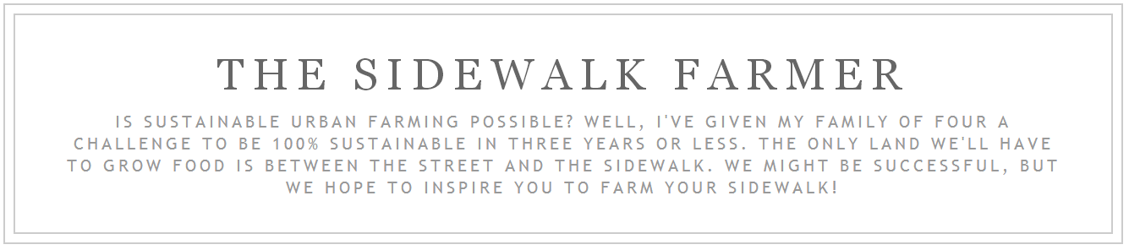
Orange tree
(not doing well)
Rhubarb
(doing fine)
See sidewalkfarmer.blogspot.com

Slide 58
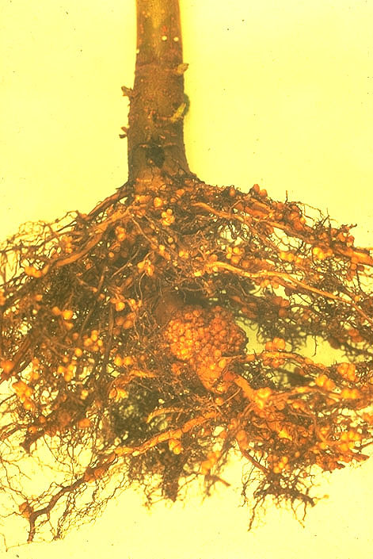
New Plant Paradigms III: Will Beans Take Over the World?
Nitrogen fixation
relieves a key constraint on crop yield
Genetically engineered root extensions
relieves other soil nutrient deficiencies
Potential for a Second Green Revolution
Source: www.reed.edu/biology/Nitrogen/Nfix1.html

Slide 59
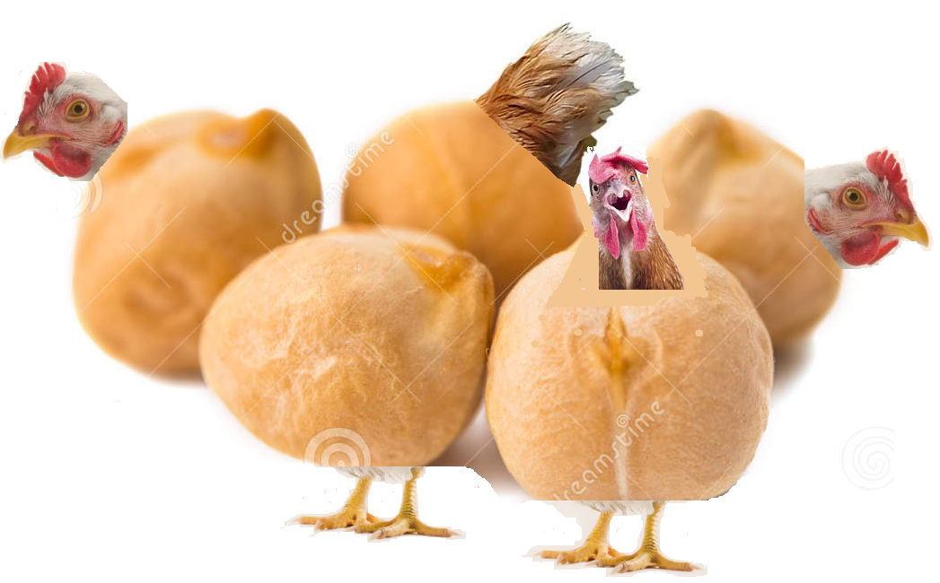
Better Beans and Other Nitrogen-Fixing Plants
Are beans everywhere an idea that is tough to swallow?
Make them taste like dumplings, or chicken nuggets
Instead of “chickpeas” we’ll have to call them “chickenpeas”
Giant sunflower seeds, corn, whatever …
engineered to fix nitrogen
Engineer crops to provide vitamins and other trace nutrients too
Graphic made from: www.chickensdirect.net/poultry/cornish-cross-chicks-fast-growing and www.dreamstime.com/royalty-free-stock-image-chickpea-image29262656

Slide 60
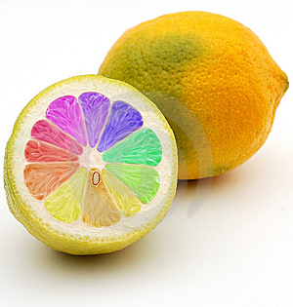
Arbitrary Food Plants
Hamburgatos
Rainbow citrus
Giant sunflower seeds
Avocadomatoes
Corn dogs
Not to forget mentioning …
Golden rice
—and other—
Highly nutritious commodity crops
Source: razkritia.com/растенията-мутанти-напират-да-пробия

Slide 61
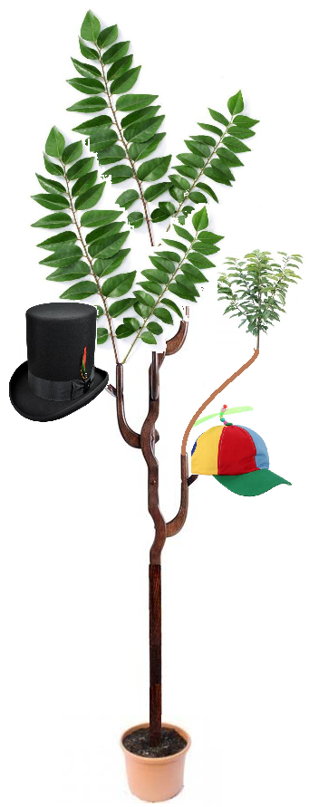

Manufacturing Plants
Collage from: www.saaraketha.com/products/karapincha-curry-leaves, pennyauctionreviews.co/wp-content/uploads/2018/08/modern-coat-trees-home-furnishing-modern-clothes-hanger-hats-rack-solid-wood-coat-rack-living-standing-hanger.jpg, 2013bestbuybest, www.villagehatshop.com/product/top-hats/451139-163375/size-m-black.html, chukysohanoi.com/cherry-tree-saplings/cherry-tree-saplings-cherry-sapling-view-specifications-details-of-plant-saplings
Source: www.thisiscolossal.com/2016/12/full-grown-trees-grown-into-furniture-and-art-objects

Slide 62
Can money grow on trees?
Heavy metal ion uptake by plants for bioremediation
So why not collect precious metal ions into blobs?
Early case was described by M. Goose (n.d.)

Slide 63

“The Little Nut Tree” (A children’s rhyme by Mother Goose)
I had a little nut tree, Nothing would it bear But a silver nutmeg, And a golden pear; The King of Spain's daughter Came to visit me, And all for the sake Of my little nut tree.
Image source: http://www.gardenofsong.com/bopeep.html

Slide 64
Basic Principle Is it Physically, Chemically, and Biologically Possible in Theory? It Can Be Done by Genetic Engineering

Slide 65

New Plant Paradigms IV: Super-Polyphenism (Alternative Forms)
Corn plants that, depending on triggers
Grow normally and die in the autumn
… or …
Grow into perennial corn-bearing trees
Principle: If it’s consistent with the laws of
physics, chemistry, and biology,
genetic engineering can do it.
Source: python.rice.edu/~brooks/Family/2006/Hawaii/Kula/Kula-Pages/Image6.html

Slide 66



Mirror Life
Plants are based on l-amino acids. Make d- ones!
Highly pest resistant!
Would make great crops for non-food uses
Source: corporate.evonik.com/misc/micro/methionine/files/bilder/struktur_methionin.jpg
Source: www.phschool.com/science/biology_place/biocoach/bioprop/landd.html
Source: chemistry.tutorvista.com/biochemistry/arginine.html

Slide 67


New Plant Paradigms V: Floating Prairies of the Sea
Fresh water model: the water hyacinth
It floats; it grows up above the water surface
Why not farm ocean gyres?
…with genetically engineered saltwater hyacinth-beans
Nitrogen fixation and long thin roots to get nutrients
Source: https://www.whatarethe7continents.com/ocean-gyres-formation-maps-more
Water hyacinths: a beautiful, tasty pest (source: US Dept. of Agriculture).

Slide 68



Floating Prairies of the Sea
By-the-wind sailors
They stay off shore (usually) without swimming
Our GM hyacinths could do the same!
How about a by-the-wind sailor + water hyacinth cross?
Source: life-sea.blogspot.com/2011/07/life-of-by-wind-sailorvelella-velella.html
Source: www.earthwindow.com/velella.html
Source: www.oregonbeachcomber.com/2014/07/by-wind-sailors-take-over-eastern.html

Slide 69

New Plant Paradigms VI: The Greenish Revolution
Stage 1 integration:
Symbiosis
Source: karlshuker.blogspot.com/2011/04/how-green-was-my-polar-bear.html
Notes:
Free food, food grown everywhere including backyards, people working less (if you want nothing from society besides food, then you should only have to work 1 week per year!)

Slide 70

The Greenish Revolution (Stage 2)
Stage 2 integration:
Plant and animal cells mingle
Convoluta roscoffensis flatworms:
“Fingerlike processes of the algal cells penetrate between adjacent animal cells.” – James Oschman
Source: jouault.wordpress.com/2013/10/10/walk-to-lavarison-and-la-pecherie-a-vraic-et-a-poisson

Slide 71

The Greenish Revolution (Stage 3)
Stage 3 integration:
Algae live intracellularly in symbiosomes
“Nanoterrariums”
Giant clams
Source: johnib.wordpress.com/2017/05/07/the-philippines-giant-clam-nursery-and-the-doting-dad-to-giant-clams

Slide 72

The Greenish Revolution (Stage 4)
Stage 4 integration:
Chloroplasts in animal cells
Sacoglossa
a taxon of sea slugs
They eat algae
Incorporate the chloroplasts
Chloroplasts die after awhile
So they eat some more
Source: www.naturamalta.com/Oxynoe_olivacea.html

Slide 73


The Greenish Revolution (Stage 6)
Stage 6 integration
Any animal or human with chloroplasts living permanently in the skin for nutritional purposes.
Basic principle:
If it is physically, chemically, and biologically possible, the rest is engineering
Sources: (l) https://www.youtube.com/watch?v=uXoskJavSFs; (r) www.shutterstock.com/video/clip-2704991-african-young-guy-facing-camera-strong-look

Slide 74

Sustainable Innovations Need Business Models
If we want oceanic hyacinth farming (or whatever):
A business model is needed to sustain it
Even a gov't program needs one (budget & so on)
Modern academia-based startup strategy involves
A business model canvas
Getting out of the building
Talking to potential future paying customers
Not always the end users
Identifying potential markets
Knowing when to pivot

Slide 75
Strange Future Plant-Based Technologies May Happen
If it’s physically, chemically, and biologically possible in principle,
the rest is “just” engineering!

Slide 76

Acknowledgments
USDA-SBIR
NSF EPSCoR via P3
Infinite Enzymes
USDA-NIFA

